Slide 1
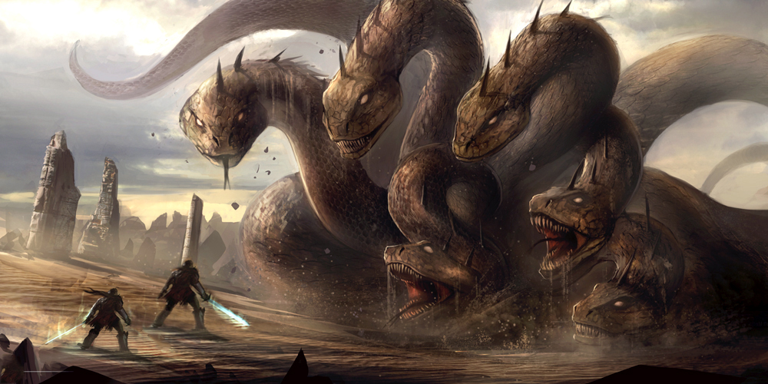
Slaying the Hydra: Against Gradualism and Toward a Comprehensive Framework to Defeat Corruption in Pakistan
SPEAKER: Andleeb Abbas
DISCUSSANT: Zahid Hasnain (World Bank)
Wednesday, January 18, 2017
12:30 – 2:00 PM
IMF HQ2-10-073

Slide 2
AGENDA
Confronting the hydra
Three arguments
War-gaming the future
Slaying the hydra

Slide 3
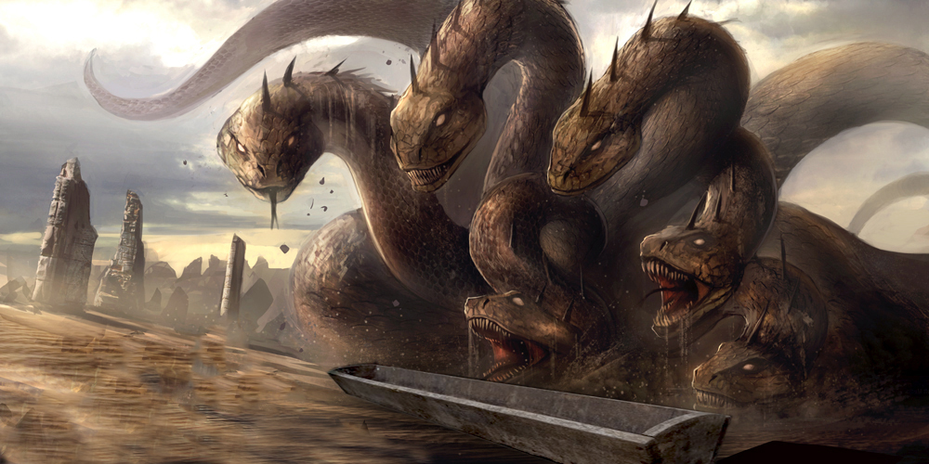
CONFRONTING THE HYDRA
Congress has appropriated more than $33 billion to Pakistan since 2002. (General Accounting Office)
Of the $920 million in military support in 2008 alone, only $300 million reached the military. The great majority unaccounted for. (The Atlantic Council)
Kerry-Lugar-Berman bill tripled US aid to Pakistan to $7.5 billion (2010-2014). (Center for Global Development)
CPEC = ~USD 46 billion. (estimate reported by Reuters, August 5 2016)
Country-reported KPIs questionable
LOANS
TAX
AID

Slide 4
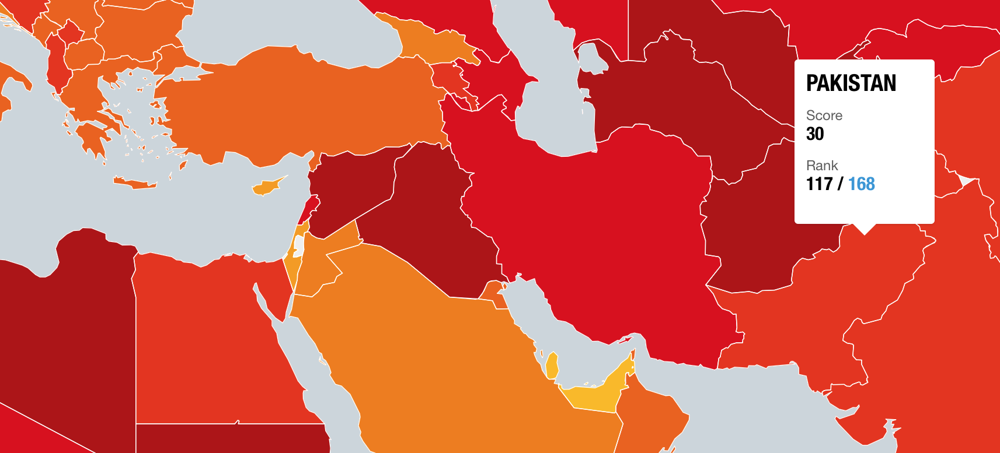
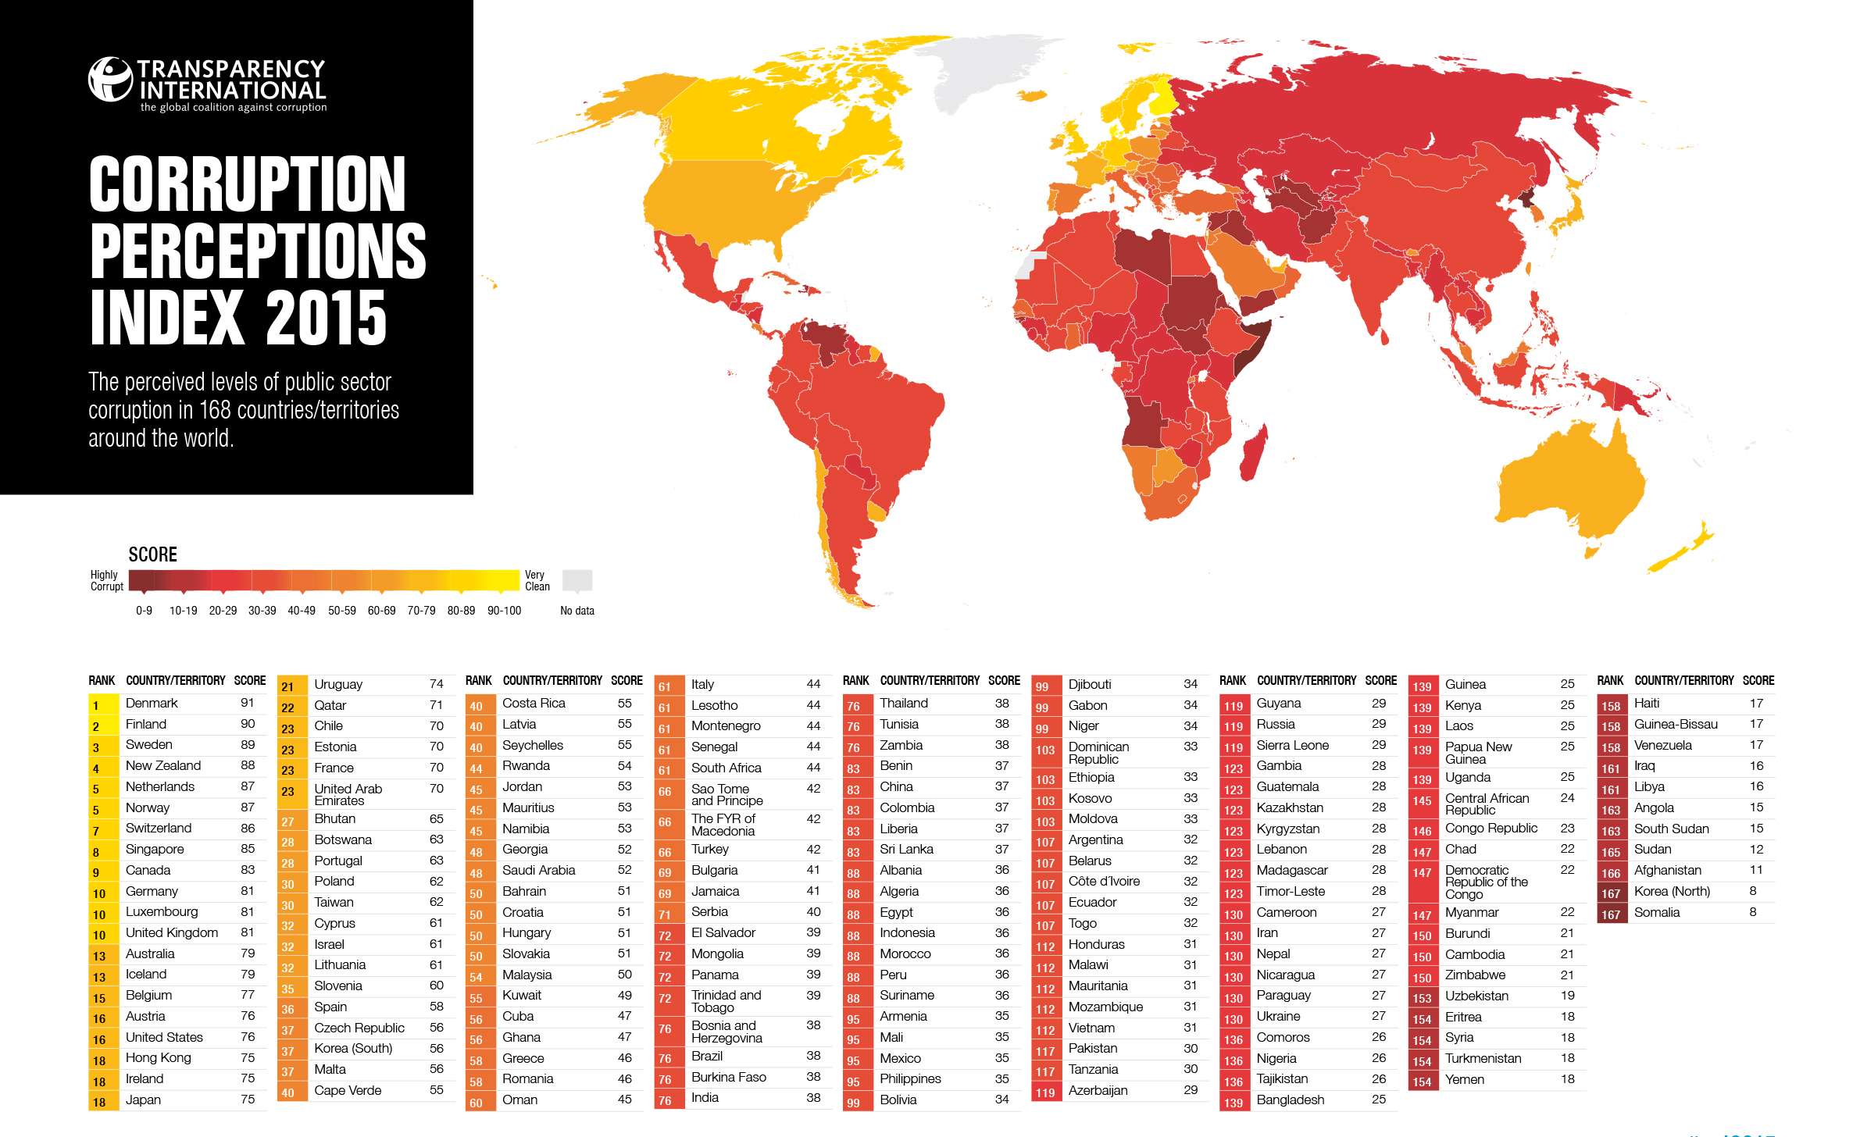
CONFRONTING THE HYDRA

Slide 5
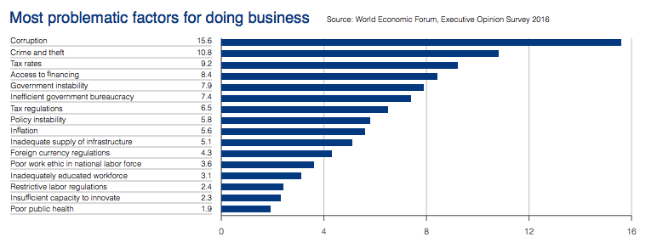
CONFRONTING THE HYDRA
CORRUPTION
World Economic Forum's Global Competitiveness 2016 report identified corruption as the most problematic factor for doing business in Pakistan

Slide 6
ARGUMENT #1
Corruption is everywhere. It is all very unfortunate, but it is business as usual, and other countries manage despite it.

Slide 7
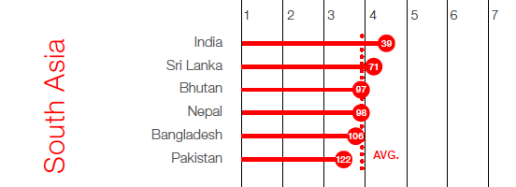
COUNTER-ARGUMENT: This is a difference of kind as well as degree
“Pakistan is the only economy that fails to improve its macroeconomic environment and health and primary education levels. The country’s score is still below the 2007 level.”
World Economic Forum Global Competitiveness Index"

Slide 8
COUNTER-ARGUMENT: The rot is deeper and the stakes are higher
VIETNAM (#112; 6.68%)
INDONESIA (#88; 5.02%)
MEDIUM HDR (116)
Geographically safe
Institutional corruption but no evidence of personal financial criminality among top leadership
No nuclear capability
MEDIUM HDR (#110)
Geographically safe
Still problematic, but aggressive anti-corruption commission (KPK) in place
No nuclear capability
PAKISTAN (#117; 4.7%)
LOW HDR (#147)
All-pervasive corruption: top leadership, all institutions, daily life)
Unsafe neighborhood
Drafted into 9/11 wars
Nuclear capability
INDIA (#76; 7%)
MEDIUM HDR (130)
No evidence of personal financial criminality among top leadership
Massive economy
No drafting into 9/11 wars
SOURCES: Transparency International (for corruption rankings); World Bank (for GDP growth); United Nations (for Human Development Report rankings)

Slide 9
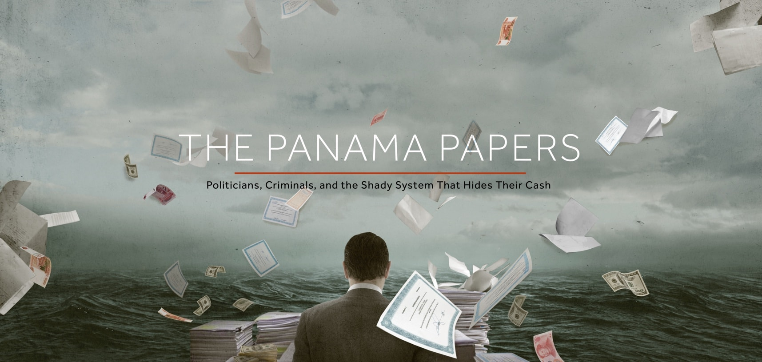
COUNTER-ARGUMENT: The rot is deeper and the stakes are higher
More than 400 Pakistanis are named in Panama Leaks
153
41
34
companies owned by Pakistanis registered in British Virgin Island
companies are based in Panama
offshore accounts revealed in Seychelles

Slide 10
f
COUNTER-ARGUMENT: The rot is deeper and the stakes are higher
Nawaz Sharif
1981- Finance Minister
1985- Chief Minister
1991- Prime Minister
Ittefaq Group
1981- 1 Factory
1985- 9 Factories
1993- 30 plus business
Pakistan GDP
Growth Rate
1981- 6.8%
1993- 2.097%
+
+
-
SOURCE: Baker, Raymond. 2005. Capitalism's Achilles Heel. New York, NY: Wiley (for linkages of Sharif and Ittefaq growth); Pakistan Economic Survey figures for GDP growth rates

Slide 11
COUNTER-ARGUMENT: The rot is deeper and the stakes are higher
SECP
SBP
AGPR
Judicial Independence
(2012-13)
55
(2016-17)
106
(2012-13)
85
(2016-17)
106
(2012-13)
86
(2016-17)
121
(2012-13)
57
(2016-17)
88
Source: Global Competitiveness Index

Slide 12
ARGUMENT #2
There is no viable alternative.

Slide 13
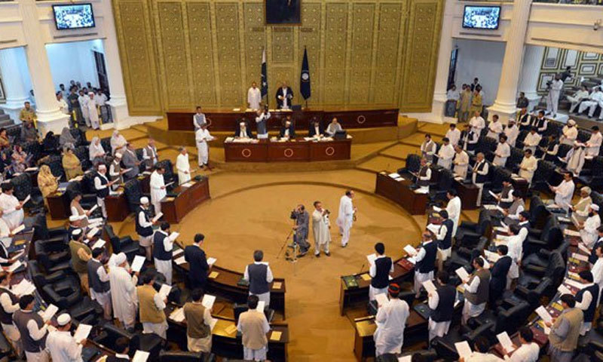
COUNTER-ARGUMENT: Three short years of shock and awe
The KP Assembly during the last 3.5 years enacted more than 133 bills and 119 acts.

Slide 14
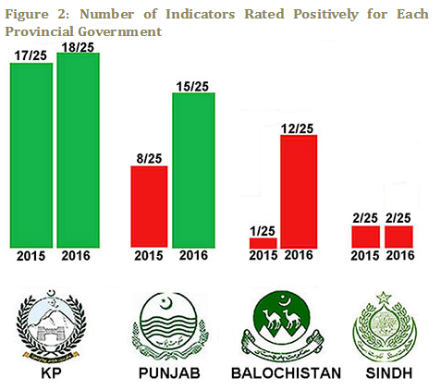
Shock & awe = BEST GOVERNED PROVINCE
With in 3.5 years KP has left all the provinces behind in terms of quality of governance.
Governance in KP rated most positively in PILDAT governance poll held in Oct 2016.

Slide 15
SHOCK AND AWE = HIGHEST GDP GROWTH

Slide 16
SHOCK AND AWE = BEST Law & order
PILDAT Governance Poll 2015

Slide 17
SHOCK AND AWE: ANTI-CORRUPTION
PILDAT Governance Poll 2016

Slide 18
SHOCK & AWE = LOWEST BRIBERY & CORRUPTION
FAFEN survey in February 2016

Slide 19
ARGUMENT #3
But better the hydra you know. The alternative is risky.

Slide 20
The connections between corruption and terrorism
COUNTER-ARGUMENT: Risk is what we have right now
Corruption and poor governance undermine the fight against terrorism
Corruption facilitates terrorist attacks
Corruption helps terrorist funding
Corruption and terrorism financing share methods to hide money
Source: OECD, February 2016

Slide 21
RISK IS WHAT WE HAVE NOW
THE PEOPLE OF PAKISTAN

Slide 22
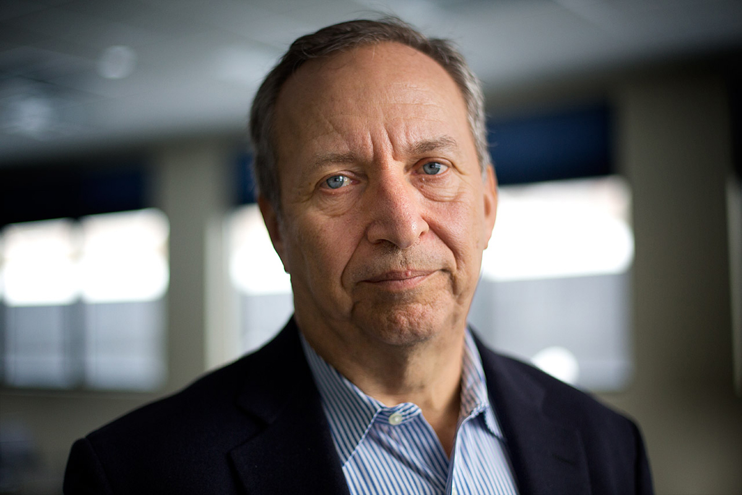
WAR-GAMING THE FUTURE
"In the history of the world, no one has ever washed a rented car"
– Larry Summers

Slide 23
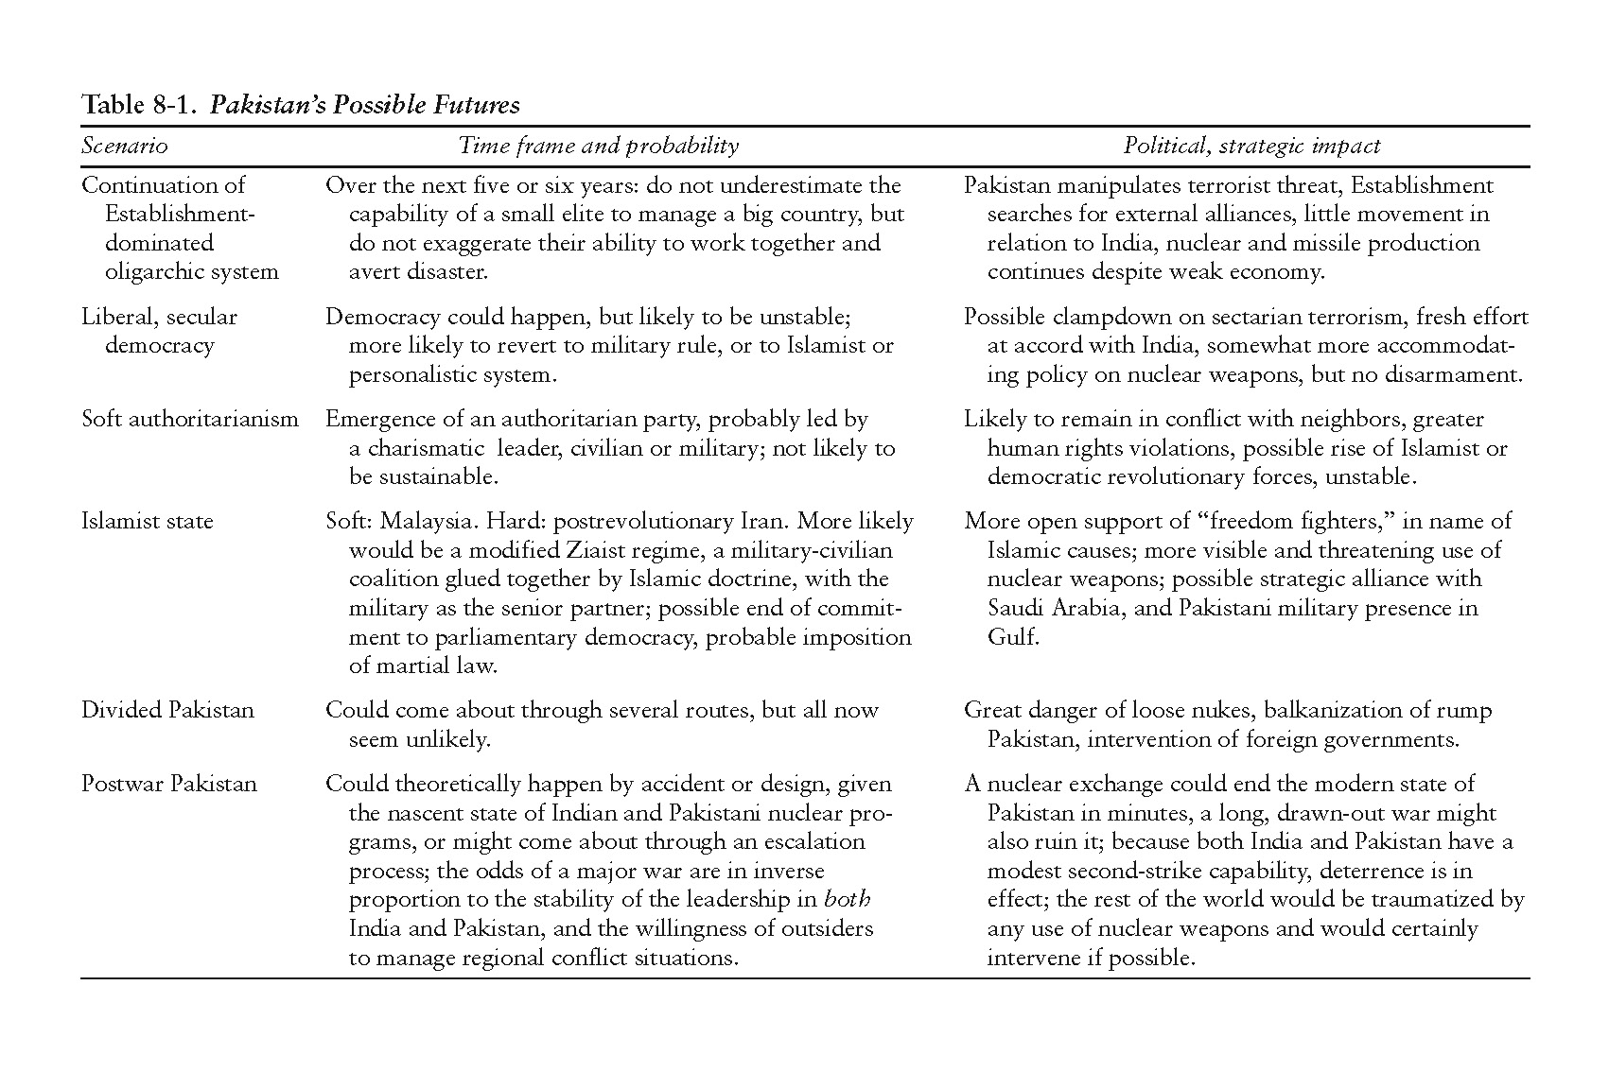
WAR-GAMING THE FUTURE
Source: Cohen, S. 2004. The Idea of Pakistan. Washington, DC: The Brookings Institution, p. 310

Slide 24
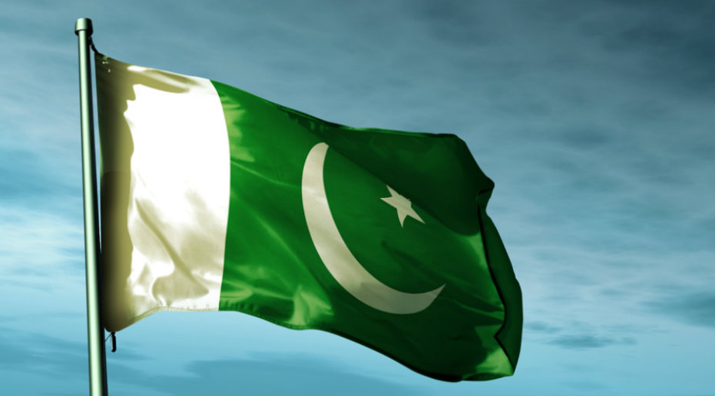
SLAYING THE HYDRA
Think relationships – not just transactions
Cross-check and verify data, especially key performance indicators
Focus on purpose, not just process
Insist on accountability & reform
Expand thinking to human development

Slide 25
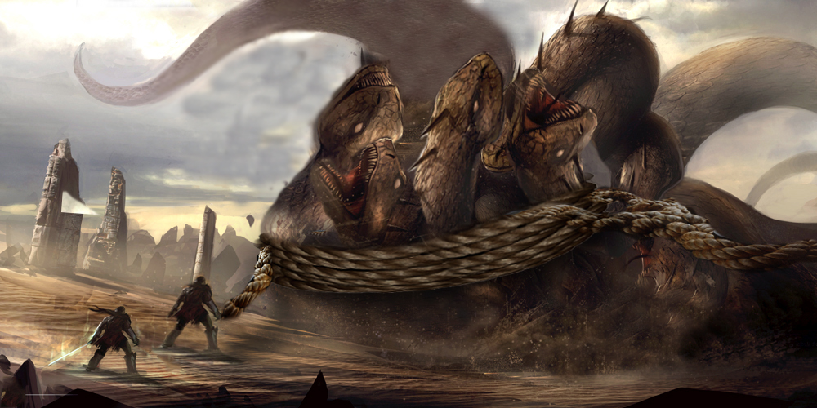
SLAYING THE HYDRA
PEOPLE OF PAKISTAN
THE INTERNATIONAL COMMUNITY

